Slide 1
Pathophysiology of Hypercapnia
Brian Locke, MD

Slide 2
CO2: Exhaust of Metabolism
Aerobic respiration:
carbohydrates: C₆H₁₂O₆ + 6 O₂ → 6 CO₂ + 6 H₂O + 38 ATP
RER: VCO2/VO2 = 6 / 6 = 1
Fat (palmitic acid): C₁₆H₃₂O₂ + 23 O₂ → 16 CO₂ + 16 H₂O + 129 ATP
RER: VCO2/VO2 = 16 / 23 = ~0.7
Glycolysis:
Glucose + 2[NAD+] + 2[ADP] + 2[Pi] → 2 Pyruvate + 2[NADH] + 2H⁺ + 2[ATP] + 2H₂O
H⁺ accumulates, H⁺ + HCO₃ → H₂CO₃ → H₂O + CO₂
RER: VCO2/VO2 = 1 / 0 = ∞, combined with aerobic respiration RER increases.
Notes:
Note: RER (metabolism) = RQ (gas exchange at lung) if no significant buffering is occurring. Above AT, no longer equal
RER = VCO2 / VO2
1.0+ if glycolysis ongoing
1.0 if all carbohydrates being oxidized
0.7 if all lipolysis (of palmitic acid)

Slide 3
Why is PaCO2 so tightly controlled?
What is a normal PaCO2? 95% of ‘normals‘ fall within this range
Sea level: 38.3 mmHg, 2 SD (95% CI) +/- 7.5 mmHg. ULN 45 mmHg
Elevation (4500 ft): 33.5 mmHg, 42 mmHg is ULN
Consider: during exercise there is no change in PaCO2 across a very wide range of VCO2
The PaCO2 value is kept with 3 mmHg throughout the Day (Nunn’s) except for transient elevations up to 10 mmHg during REM sleep.
The expected PaO2 declines with age (roughly 0.24 mmHg/year), PaCO2 does not change.
Notes:
95 CI citation – Nunn’s
Elevation: https://www.atsjournals.org/doi/full/10.1164/ajrccm.160.5.9806006

Slide 4
There is no apparent harm from transient CO2 elevation
Respiratory failure: defined as failure to maintain normal arterial blood gas partial pressures.

Slide 5
CO₂ Kinetics
VA = K * VCO2 / PaCO2
Alveolar ventilation is proportional to the ratio between CO2 production and the level of CO2 in the blood.
VA = VE (1- [Vd/Vt])
Alveolar ventilation is the minute ventilation minus the fraction of minute ventilation that does not participate in gas-exchange (aka wasted ventilation fraction, or deadspace fraction)
PaCO2 = K * VCO2 / VE (1-[Vd/Vt])
Notes:
“Important to note than PaCO2 over 44 mmHg is not synonymous with hypoventilation - as it could also be due to increased VCO2 (from exercise, increased work of breathing, weight gain, hyperthermia, carbohydrate utilization, hyperthyroidism, etc.)”

Slide 6
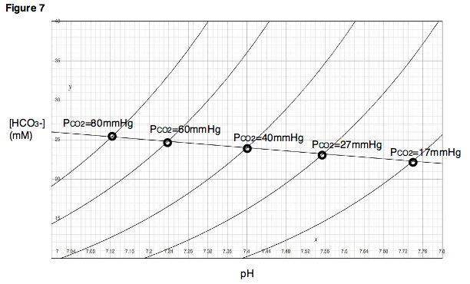
Why does the body use PaCO2 35?
⬇️ VA = K * VCO2 / PaCO2 ⬆️
The same pH can be achieved at any PaCO2 by adjusting the bicarbonate: pH = 6.1 + log [ HCO3 / (0.03 * pCO2) ]
Ventilation is metabolically expensive
work of breathing = 2% of O2 at rest
increases hugely with exercise or pathology
Why doesn’t the body operate with with a PaCO2 of 70? (and an HCO3 of 44 = pH 7.42)
Davenport Diagram; visualizes Henderson-Hasselbach Relationships
Notes:
Would be especially in states where the work (power) of breathing is higher - such as lung disease
54 - Cunningham DJC, Robbins PA, Wolff CB. Integration of respiratory responses to changes in alveolar partial pressures of CO2 and O2 and in arterial pH. In: Cherniack NS, Widdicombe JG, editors. Handbook of Physiology, Section 3. The Respiratory System. Volume II: Control of Breathing, part 2, Bethesda, MD: Am Physiol Soc, 1986, pp. 475-528.

Slide 7
Why doesn’t PE cause hypercapnia?
⬆️ PaCO2 = K * VCO2 / VE (1-[Vd/Vt ⬆️])
PaCO2 changing ALWAYS must indicate either a failure of the control system (won’t breathe), the mechanical systems response to an increase in demand or a constraint (can’t breathe), or both
Increase in demand for VE: increase in VCO2, increased in Vd/Vt, (compensation for metabolic acidosis*)
Constraints: load on respiratory muscles or reduction in their strength
Notes:
Can you sustain what you need

Slide 8
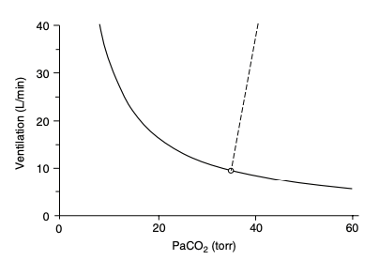
Metabolic Parabola
If you hold VCO2 and Vd/Vt constant and plot:
PaCO2 = K * VCO2 / VE (1-[Vd/Vt])
Hypothetical demand from metabolic acidosis
Controller Response: Hypercapnic Response to Ventilation
Hypothetical move toward a new higher CO2 set-point to reduce work of breathing
Notes:
Tobin comprehensive physiology

Slide 9
How much demand can people handle?
Back-of-the-envelope math with CPET normal values give a sense
Normal 70kg, 60-year-old female = VO2 at peak 1.66 L/min (24.5 mL/kg/min)
3.5 mL/min/kg = 1 met; thus, normal capacity of 7 Mets
Normal ventilatory reserve is 15% or more
Thus, normal individuals can tolerate ~8.8-fold increase in VCO2 without a change in PaCO2
Equivalent to an 89% Vd/Vt; this is why PE does not cause hypercapnia in the absence of control or mechanical system failure
TODO: normal values for MVV?
Notes:
From CHEST 2021 Canada reference. CHEST 2021; 159(5):1922-1933
Even if VO2 max is only 50% of predicted, that’s still a large range of deadspace / VCO2 that the pulmonary system can handle unless there is a mechanical impediment.
Not taking into account RER changes (and their absence reflected in RQ not being at steady state)
A change in Vd/Vt or VCO2 can be a stressor on the system, but in the absence of huge extremes (e.g. 2,4 Dinitrophenol overdose) is not the cause itself (unless control system is offline - on vent)

Slide 10
The PCO2/Ventilation Response ‘Curve’
Controller Response: Hypercapnic Response to Ventilation
Sensitivity of controller system: force an increase in PaCO2 and observe how much VE increases.
Represented by the straight, dashed line
Ventilation = S (PCO2– B)
S is slope (Δ VE / Δ PaCO2)
B is the intercept at zero ventilation.
Steeper: more sensitive. Flatter: less sensitive
Normal range 0.5-8.0 L/min/mmHg (surprisingly wide)
80% of subjects have a response between 1.5 and 5 L/min/mmHg
Notes:
Controller system sensitivity can be evaluated by forcing an increase in PaCO2 and measuring a subsequent increase in Ve – straight line, where change in Ve per mmHg paCO2 = sensitivity.
-normal range in healthy adults is 0.5 to 8.0 L/min/mmHg (1.5-5.0 in 80% of subjects) (269) - 269 - Tobin MJ, Gardner WN. Monitoring of the control of ventilation. In: Tobin MJ, editor. Principles and Practice of Intensive Care Monitoring. New York: McGraw-Hill, Inc., 1998, pp. 415-464
118. Irsigler GB. Carbon dioxide response lines in young adults: The limits of the normal response. Am Rev Respir Dis 114: 529-536, 1976
This is citation for normal range
313. Younes M, Georgopoulos D. Control of breathing relevant to mechanical ventilation. In: Marini JJ, Slutsky AS, editors. Physiological Basis of Ventilator Support. New York: Marcel Dekker, Inc., 1998, pp. 1-73.
(306) – Younes M. Mechanisms of ventilatory failure. Current Pulmonology 14: 243-292, 1993a.

Slide 11
Measuring Controller Sensitivity

Slide 12
Breath Holds
PaCO2 causes an irresistibly strong urge to breathe in individuals with normal respiratory systems
on room air, typically near 50 mmHg (diaphragmatic contractions occur at PaCO2 ~46-49)
on supplemental oxygen, can tolerate much longer (highly trained apneass can increase their conventional breakpoint to critical hypoxia, which is 20-30 mmHg O2)
can be extended by rebreathing gas (the sensation of air hunger is partially mediated by lack of movement in / out)
Notes:
Comprehensive physiology breath hold diving paper
Recall:
Any values of PaCO2 above 46 mmHg is abnormal – though transient elevations up to 50 mmHg may be encountered in ‘normal people’ doing breathe holds. West: held within 3mmHg always, possibly slightly higher in sleep. (10mmHg is the threshold for noct vent)

Slide 13
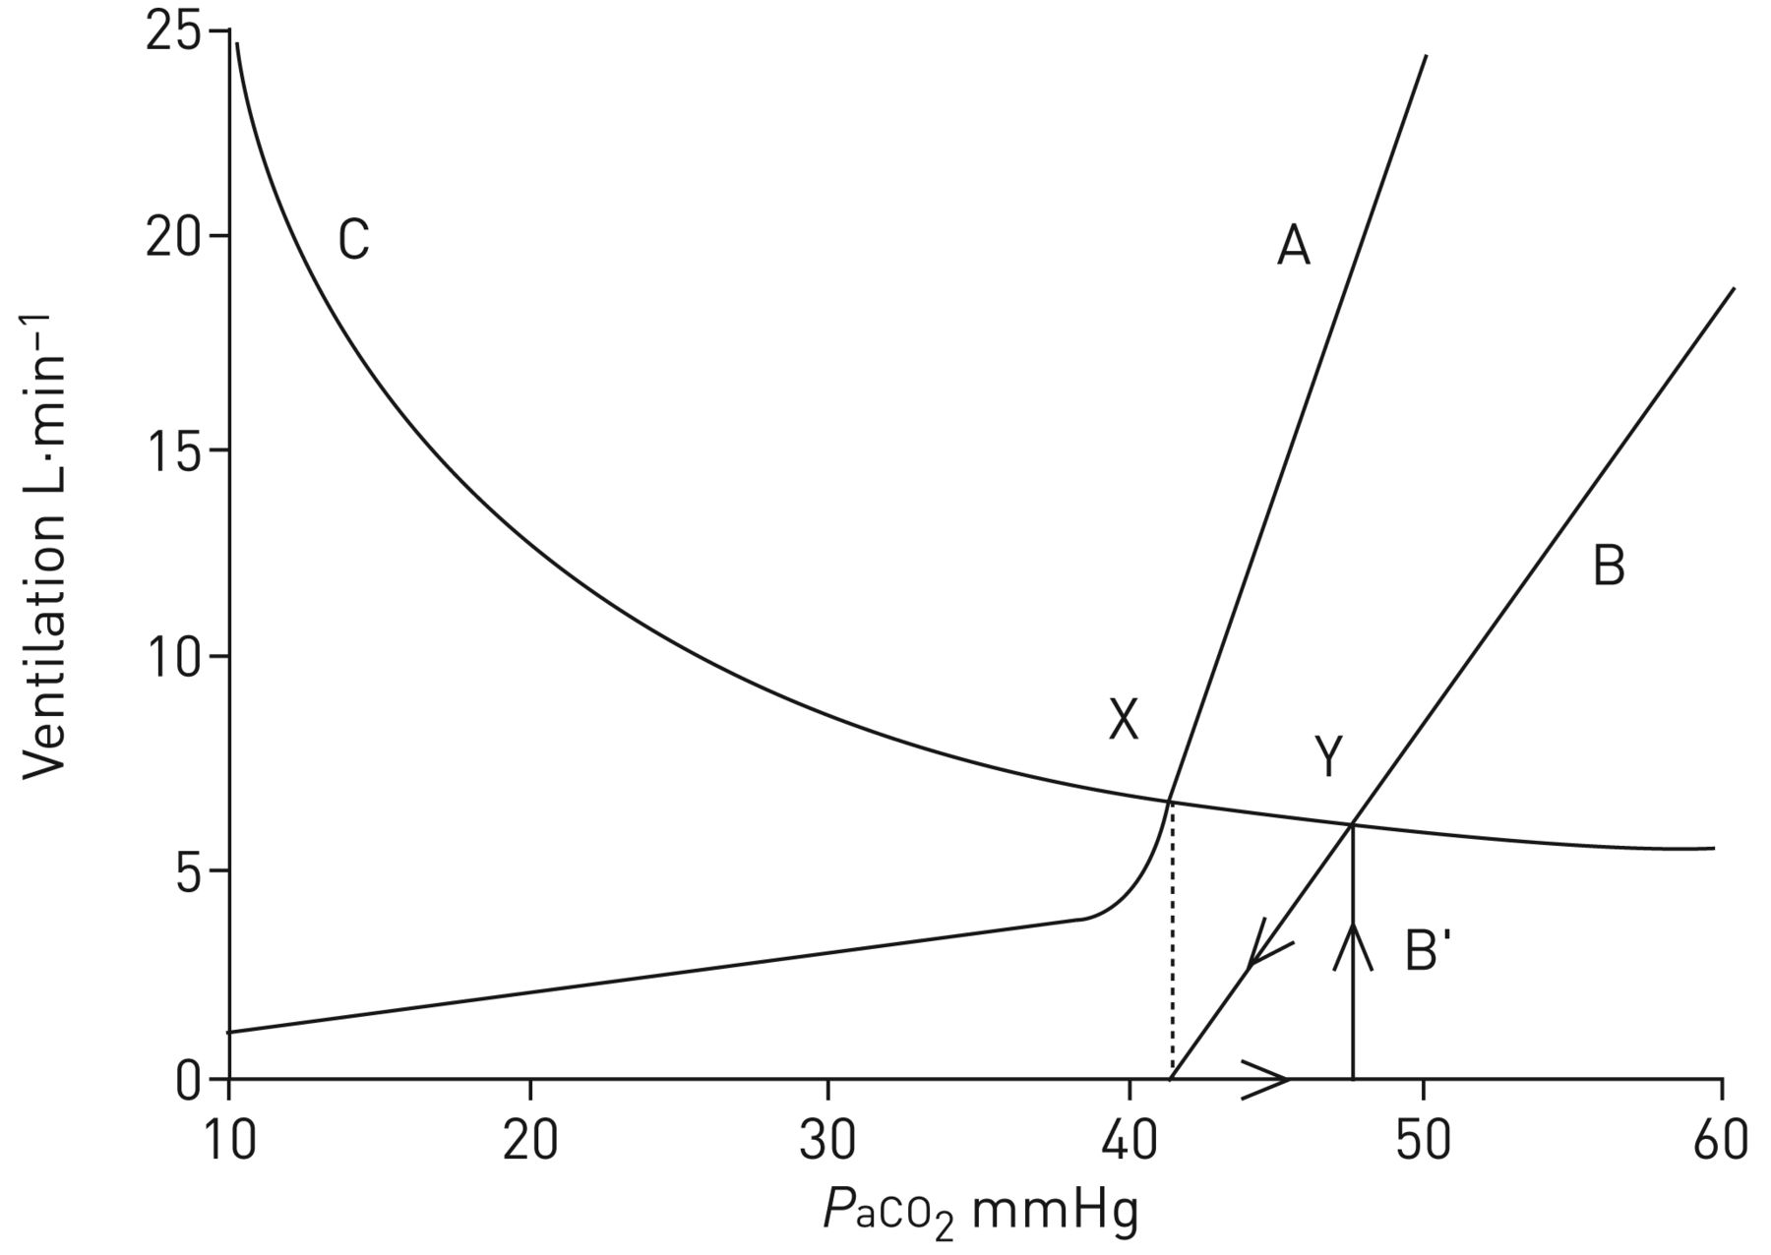
Things that change controller sensitivity
Normal Controller: A
Opiate Controller: B (50% reduction in sensitivity)
Note: if opiate is administered, apnea can occur due to the absence of ‘hockey stick’ portion
Note²: PaCO2 doesn’t change all that much (7mmHg) despite decreased sensitivity (50%)
Notes:
From https://erj.ersjournals.com/content/51/3/1702531#ref-8
Note: in this case, the opiate only caused a ~7 mmHg increase in PaCO2 despite a 50% reduction in sensitivity of the hypercapneic ventilatory response.

Slide 15
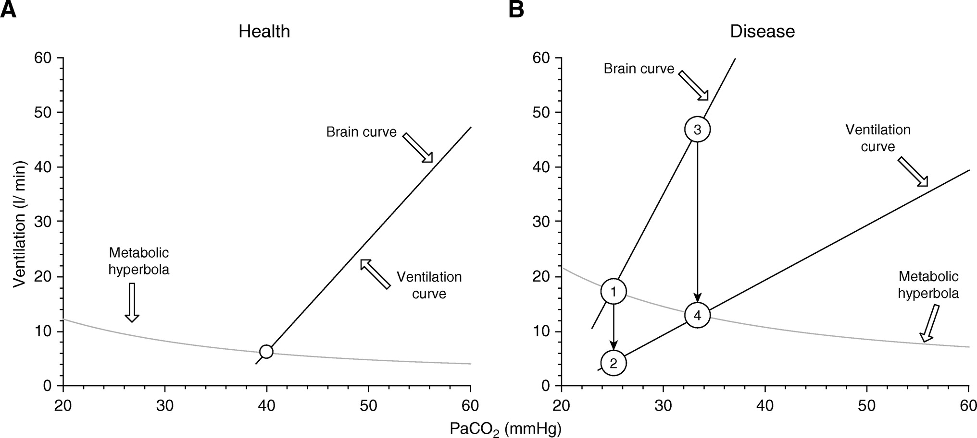
Can’t Breathe
B. Pneumonia
metabolic acidosis and hypoxemia steepens the brain curve slope
Decreased compliance flattens ventilation curve
Brain Curve
Ve the respiratory controller wants (if mechanical system intact)
Ventilation Curve
Actual Ve the mechanical system can achieve
Dissociation of the curves is air hunger
increased VCO2 and deadspace (metabolic parabola moves up)
Notes:
Disease: pneumonia.
Leads to Also leads to
Thus, the resulting gap causes air hunger, the major component of dyspnea.
Graphical representation of the metabolic hyperbola and brain–ventilation curve of a healthy human. The intersection of the metabolic hyperbola and ventilation curve (open circle) determines the steady-state Pa_{CO2} and V.V.e (40 mm Hg and 6.2 L/min, respectively). (Note that these mathematically described curves and relationships are simplified presentations of experimental data, with the aim being to facilitate understanding of the effects of critical illness and mechanical ventilation on respiratory drive, and cannot be directly applied to compute the ventilatory demands of a critically ill patient.) (B) This human develops severe pneumonia, causing increased V.V.co₂ and Vd/Vt, which moves the metabolic hyperbola upward, and hypoxemia, which moves the brain curve to the left and increases its slope. Owing to increased respiratory system elastance, a given respiratory center output per minute (RCO/min) results in a lower V.V.e; thus, the slope of the ventilation curve is shifted downward. A dissociation of the ventilation curve from the brain curve occurs. In the presence of a dissociation, any change in Pa_{CO2} alters the RCO/min (mainly due to change in respiratory drive, RCO per breath) as much as the brain curve dictates, and any change in RCO/min can only change the actual ventilation as much as the ventilation curve dictates. Assuming for simplicity that the change in respiratory system elastance, and thus the deviation of the ventilation curve, occurs abruptly, the RCO/min corresponds initially to point 1 (V.V.e, 17.5 L/min), whereas the actual V.V.e drops to point 2 (4.5 L/min). This decrease in ventilation leads to a gradual increase of Pa_{CO2}, which in turn stimulates the respiratory center. The RCO/min progressively increases along the brain curve (from point 1 to point 3), following the increase in Pa_{CO2}. In parallel, this increase in RCO/min results in an increase in the actual V.V.e along the ventilation curve (from points 2 to 4). When RCO/min (point 3) results in an actual V.V.e at the intersection of the ventilation curve and the metabolic hyperbola (point 4), a steady state occurs; Pa_{CO2} stabilizes; and respiratory drive, RCO/min, and V.V.e do not increase further. Although the brain’s ventilation demands (46 L/min) are not met (actual V.V.e, 13 L/min), respiratory drive and RCO/min do not increase further because the CO₂ stimulus is constant.
Air hunger is the most prominent sensation in severe dyspnoea (Stevens et al. 2019); it is the extremely uncomfortable sensation that arises when ventilation (sensed via stretch receptors) fails to meet demand (conveyed by corollary discharge from brainstem to cerebral cortex) (Abstract Figure). Under conditions of fixed mechanical ventilation, air hunger can be induced by hypoxia and/or hypercapnia in proportion to level of chemoreflex stimulation of ventilation (Moosavi et al. 2003).

Slide 16
How well does nl a-a exchange exclude obstructive lung da?
Mechanism of paco2 - not v/q matching bc co2 dissociation is linear so over and under ventilation CAN compensate - unlike V/Q matching’s effect on hypoxemia
Additionally, it is directly sensed and thus respiratory compensation occurs
Notes:
The emergence of photosynthetic organisms 3 billion years ago increased the PO2 levels in the atmosphere and allowed the evolution of organisms that use glucose and O2 to produce ATP through mitochondrial electron transport and oxidative phosphorylation

